Slide 1
WASP Summer School Kiwi – Grupp X
Gustaf Waldemarson
Jonas Krook

Slide 2
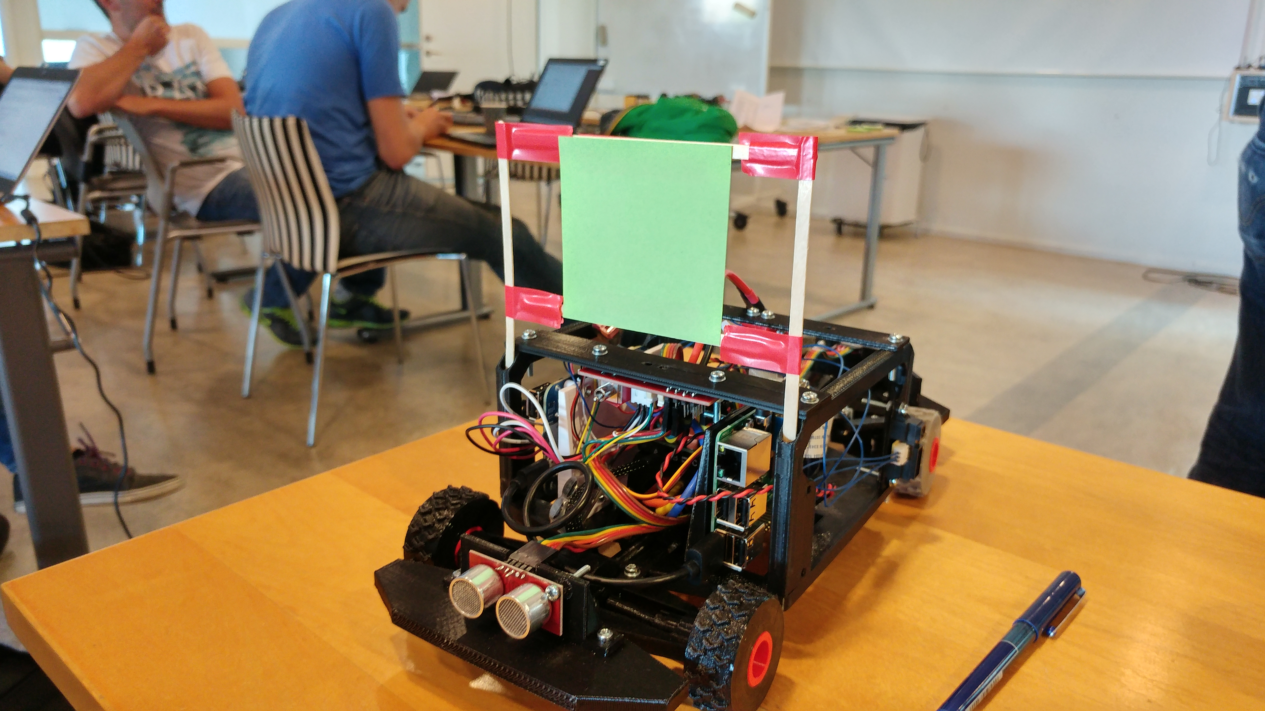

Slide 3
Color Tracker
RGB → HSV
Gaussian blurring +
Image morphology: Erode + Dilate x2, then
Select largest contour in the image:
Sanity check based on contour area.
Extracting target estimates:
Steering angle from contour-centre
Distance estimate from contour box height

Slide 4
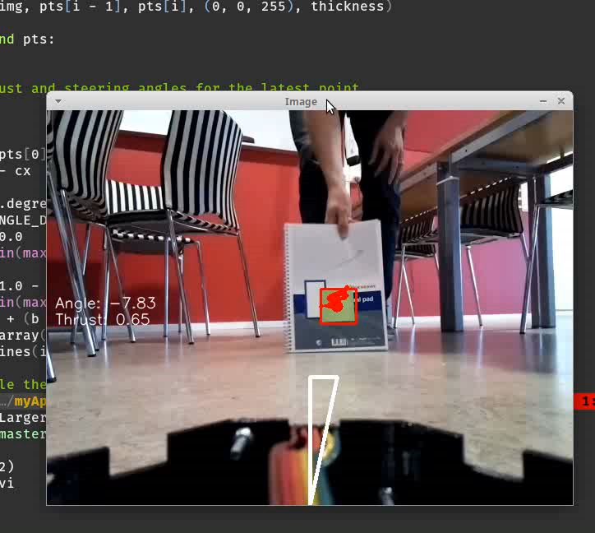
Tracker Demo

Slide 5
Sensor Fusion
Timestamp data from camera and ultrasonic sensor
Map the distance estimate from camera to meters
Distance measurements from ultrasonic sensor and camera are input to a IIR filter as they arrive

Slide 6
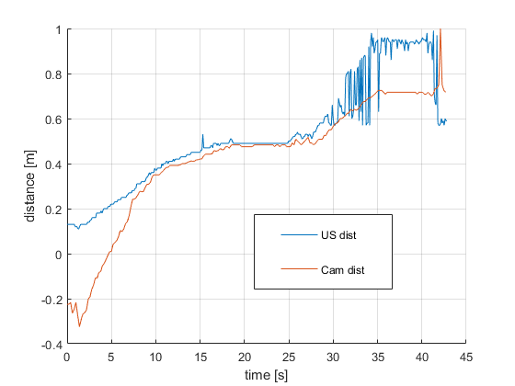
Distance Estimation

Slide 7
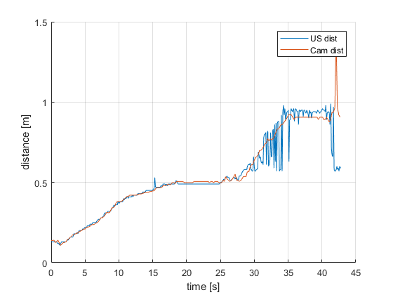
Distance Estimation

Slide 8
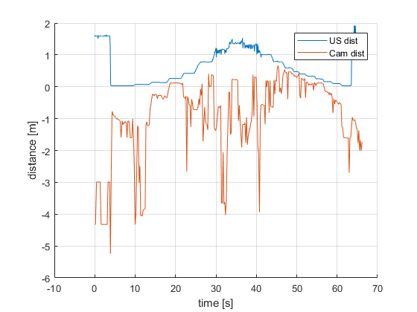
Distance Estimation

Slide 9
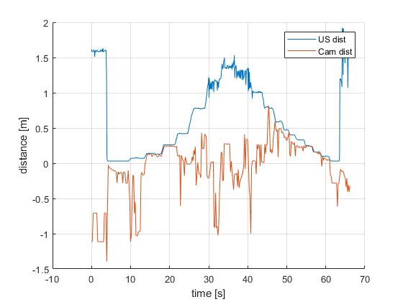
Distance Estimation

Slide 10
Control System
Simple P-controller for the steering
PD-Controller for the acceleration
Works nice based on ultrasonic sensor

Slide 11
This work is licensed under a Creative Commons Attribution-ShareAlike 3.0 Unported License. It makes use of the works of Mateus Machado Luna.

